Slide 1
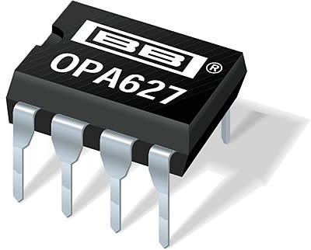

Slide 2
What is the gain of this amplifier?
+10
-10
+11
-11
+0.1
V_{in}
V_{out}
100k
10k

Slide 3
Describe the frequency dependence of this amplifier, assuming the op-amp is dominant pole compensated.
its like an RC high-pass filter
like an RC low-pass filter
independent of frequency out to f_{T}
it has a gain of 2
it has a gain of 3
V_{in}
V_{out}
20k
10k

Slide 4
Suppose the unity gain frequency of the op-amp in this circuit is 20 MHz. What is the 3dB frequency of the amplifier?
200 MHz
20 MHz
220 MHz
110 kHz
1.8 MHz
V_{in}
V_{out}
100k
10k

Slide 5
Why not replace this circuit with an RC low-pass filter?
Good idea. The RC filter would be cheaper and more reliable.
No, this circuit has gain
Good idea. The RC filter uses less power.
Depends on how you plan to drive the circuit
Depends of what the circuit
will drive
V_{in}
V_{out}
10k
10k

Slide 6
H3
What is the gain?
-0.5
-2
3
-0.333
This circuit won’t work
10k
20k
V_{in}
V_{out}

Slide 7
H3
What is the bandwidth of this circuit if the op-amp f_{T} is 100 MHz?
10 MHz
1 MHz
100 MHz
10 kHz
This circuit won’t work
1M
10k
V_{in}
V_{out}

Slide 8
H3
What is the input impedance of this circuit at low frequencies?
Very small, depends on A of op-amp
Close to 100k
Very large, depends on A of op-amp
Close to 10k
Cannot be determined
100k
10k
V_{in}
V_{out}

Slide 9
H3
What is the output impedance of this circuit at low frequencies?
Very small, depends on A of op-amp
Close to 100k
Very large, depends on A of op-amp
Close to 10k
Cannot be determined
100k
10k
V_{in}
V_{out}

